Slide 1


Do ventilated patients with pain receive boluses of sedation?

Slide 2


Pain or agitation?

Slide 3


Does it matter?

Slide 4
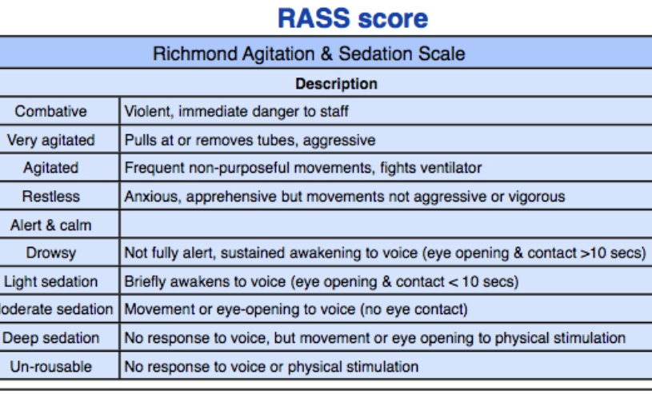
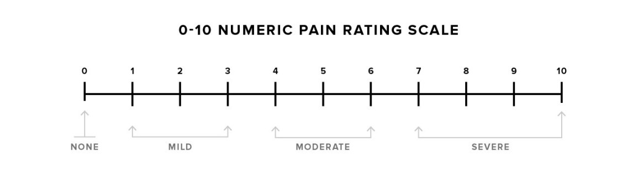

Slide 5
MIMIC IV
Exclude;
-Cardiac surgery
-ECMO
-Neurosurgery
-Traumatic brain injury
-Palliation
Pain scores (0-10);
0 = no pain (exclude)
1-3 = mild
4-6 = moderate
7-10 = severe
Intubated
Infusion of;
Sedation (S) vs Analgesia (A)
vs Sedation & analgesia (SA)
Pain score during period of intubation
? RASS
Bolus of medication shortly after? (<30mins)
If yes;
S
A
SA
& pain score in consecutive hour

Slide 6

Hypothesis; Patients with more severe pain are more likely to be given a bolus of sedation

Slide 7
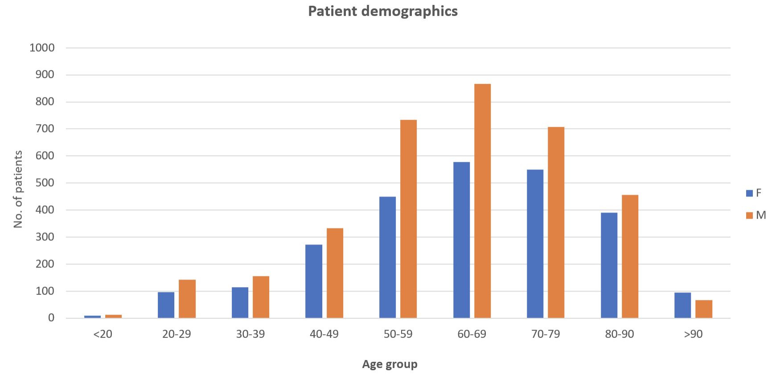
Demographics; age and gender

Slide 8
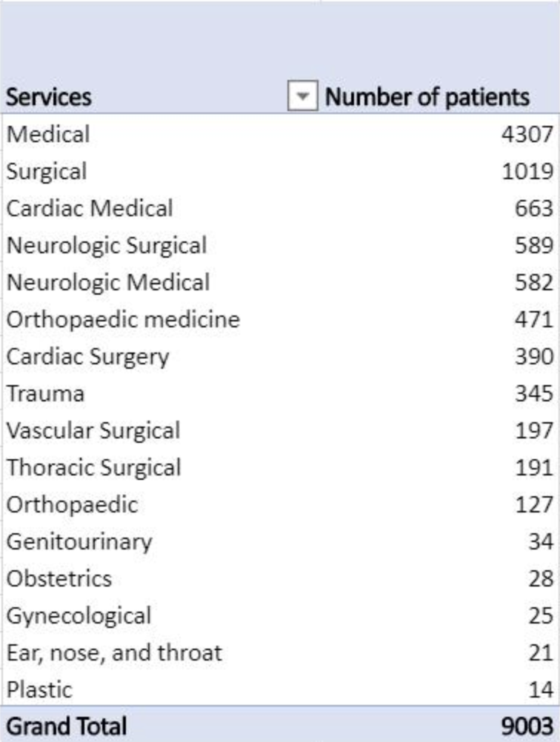
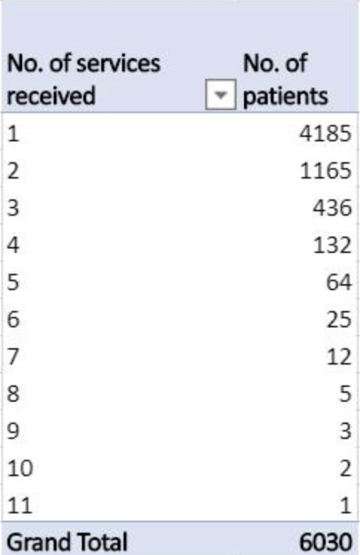
Demographics; by specialty
1,845 patients had 2 or more services during their admission

Slide 9
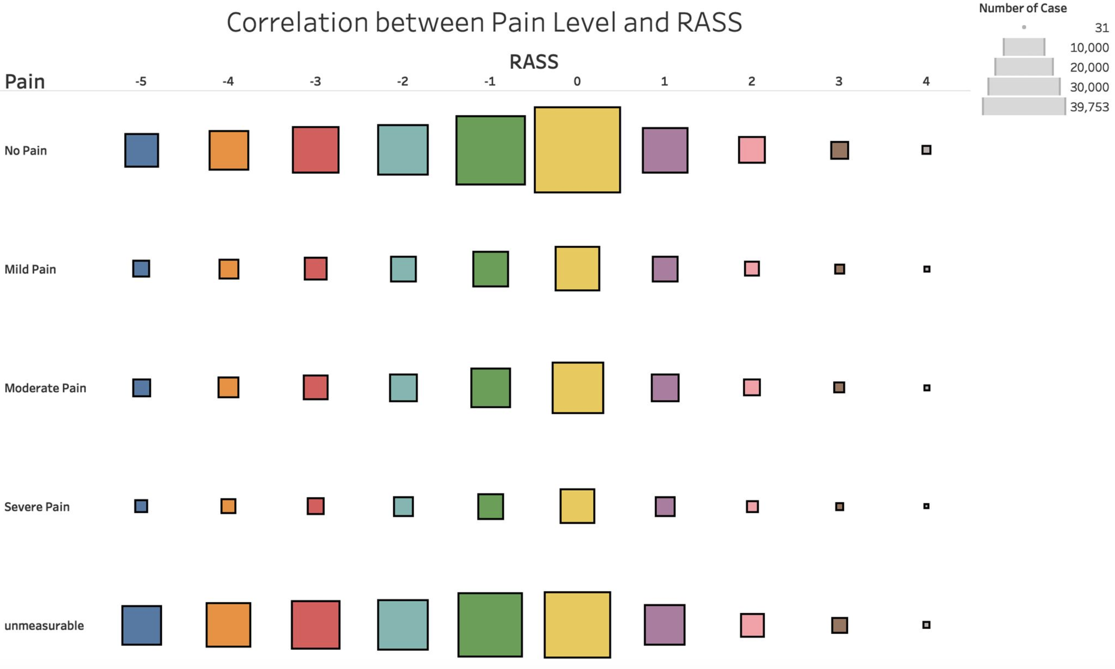
Number of events

Slide 10
We faced challenges…
The cloud…
Cleaning data…
Variance in data coding…

Slide 11

It’s not over!

